Slide 1
Music & Early Recollections: Then & now
2016 NASAP Conference
Twin Cities, MN
Tammy Shaffer Ed.D, LPCC, LCFC, NCC, CT/RTC
Walden University
Tammy.Shaffer@waldenu.edu

Slide 2
Why then?
Adler discussed early recollections as a means for uncovering “valuable hints and clues in finding the direction of a person’s striving. They help reveal values to be aimed for and dangers to be avoided. They help us see the kind of world a particular person feels he lives in, and the early ways he found of dealing with that world” (excerpted from Henry Stein’s The Collected Clinical Works of Alfred Adler, Volume 7).

Slide 3
Why now? Consider the song, and answer…
I am ______________.
Others are ______________.
The world is ______________.
In order for me to fit in and belong, I _______________________.
Notes:
Part of lifestyle assessment

Slide 4
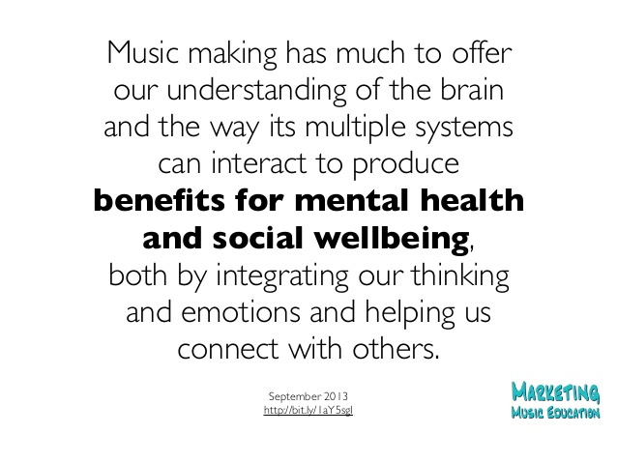

Slide 5
“Among the psychological expressions some of the most revealing are individual memories. Memories are reminders we carry with us of our limits [and strengths] and the meaning of circumstances. The memory represents the story of my life, a story I repeat to myself to warn me…and to prepare me by means of past experience so that I will meet the future with an already tested style of action.” – Alfred Adler (1931)

Slide 6
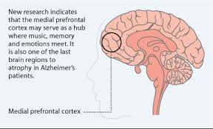

Slide 7
Mind-body connection
“… researchers showed that 15 minutes after participants listened to their favorite song, their brains flooded with dopamine” (Salimpoor and Zatorre, 2013)

Slide 8
Early Recollections: Follow-up
Ask about feelings related to the most vivid aspect.
Help the client interpret the early recollection.
Consider the theme of the memory
Clarify the main idea
Determine which of the following to consider:
Degree of activity
Social interest
Optimism/pessimism
Self-efficacy
Conscientiousness

Slide 9
“Meanings are not determined by situations, but we determine ourselves by the meanings we give to situations” (Adler, A).

Slide 10
“The memory evokes painful feelings, but there are also features of the remembrance which present more hopeful aspects… As with many early recollections, the memory suggests personality strengths and potential areas for development. The ultimate value of understanding the meaning of the remembrances is to be able to recognize individuals’ unique ways of being and to enhance human functioning” (Clark, A).

Slide 12
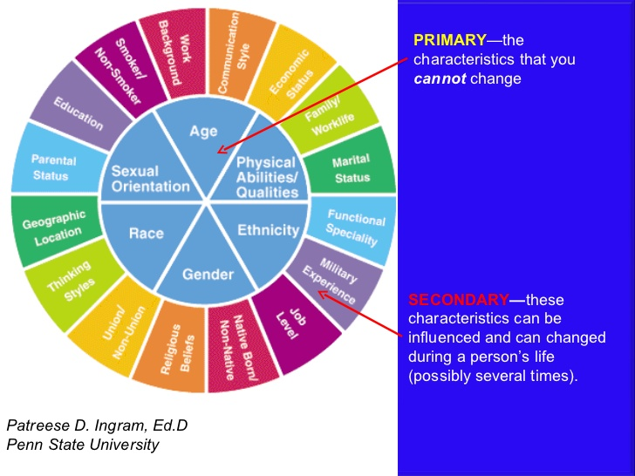

Slide 13
Notes:
Following up on diversity
Power of letting client’s choose their music, though we may deliberately choose provocative songs, at times. See list end of presentation on topics.
Be aware! Katrina diversity story and Elvis’ Trilogy

Slide 14
Early recollections
Notes:
Song clips

Slide 15
Are you listening???

Slide 16
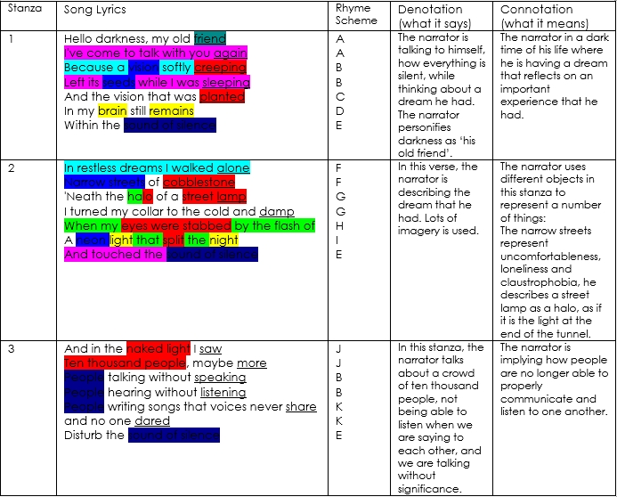

Slide 17
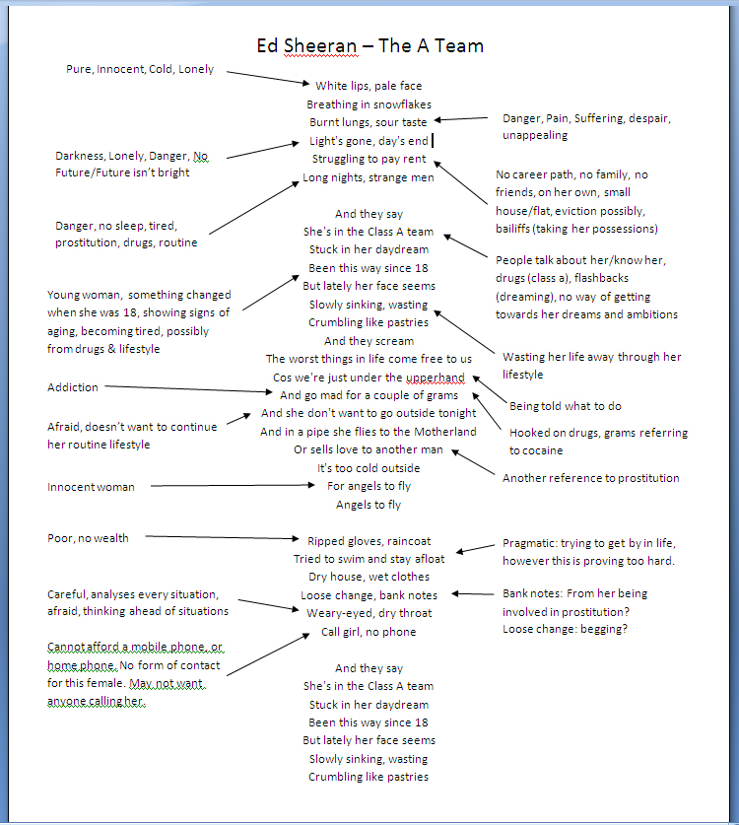
Notes:
Play song clip

Slide 18
Notes:
Play song clip

Slide 19
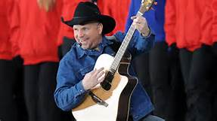
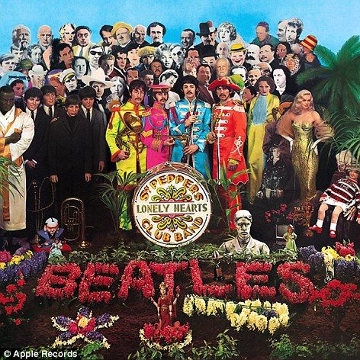
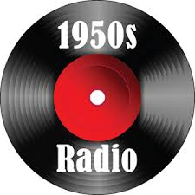
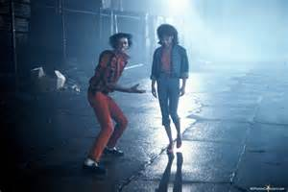

Slide 20
Notes:
Madonna covers all the decades!

Slide 21
Your turn: Questions to get you started
What message do you think the artist is trying to communicate through his/her music?
What values and attitudes are being portrayed?
Do the lyrics relate to issues the client is presenting? How so?
What meaning does the client take from the lyrics?
What are your reactions to the lyrics? To the music?
What are your emotions?
What does the song remind you about that time period in your life?
Does the song mean the same thing today?

Slide 22
Early Music memory exercise
Choose a song that evokes a memory related to your early childhood or adolescence.
Describe what you see in the memory focusing on your experience THEN. How is the song connected?
What feelings do you experience within this memory? What words from the song have meaning?
What strategies did you use to manage emotions/change THEN?
How are the strategies and feelings different or the same in your life NOW?
How does the song make you feel/think when you hear it/think of it today?
Rewrite the memory as you wish it could have happened. How would you change your response, the circumstances, the other people (if any present in your memory)?
How would this make your life better/different?

Slide 23
Song Resources
Songs about Substance Abuse Recovery
http://hopecenterrehab.org/our-top-songs-for-recovery-addiction/
Songs about Childhood Memories
http://www.mademan.com/mm/10-best-childhood-memories-songs.html
Songs that Deal with Childhood Abuse or Domestic Violence
http://www.songfacts.com/category-songs_that_deal_with_child_abuse_or_domestic_violence.php
Songs about Depression
http://www.nme.com/list/50-songs-about-depression/404368
Songs about Anxiety
http://www.kickfear.com/best-anxiety-ocd-phobia-songs.html

